Slide 1

Computing Algorithms
A Brute-Force Implementation to solve the Convex-Hull Problem
Youssef Yasser

Slide 2
Introduction
Real Life Applications
Algorithm
Time Complexity
Test Cases
Divide & Conquer
Agenda

Slide 3
Introduction
Finding the convex-hull for a given set of points in the plane is one of the most important problems in computational geometry. It is important for a variety of applications in which this problem needs to be solved, either by itself or as a part of a larger task.

Slide 4
Introduction
Several such applications are based on convex hulls which provide convenient approximations of object shapes and data sets given. For example, in computer animation, replacing objects by their convex hulls speeds up collision detection; the same idea is used in path planning for Mars mission rovers. In this project the students are asked to implement a brute-force algorithm to find the convex-hull of a set of points, test it with different test cases, then compare this brute-force algorithm with the divide-and-conquer one for the same problem against time complexity.

Slide 5
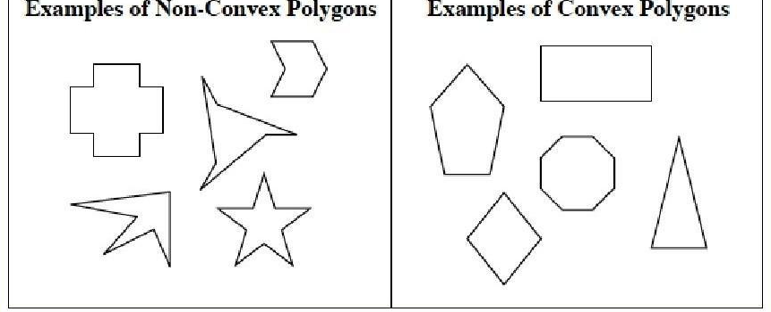
Convex VS Non-Convex

Slide 6
Real Life Applications
Collision Avoidance: If the convex hull of a car avoids collision with obstacles, then so does the car. Since the computation of paths that avoid collision is much easier with a convex car, then it is often used to plan paths.
Image Processing: Convex hull in image processing is a morphological process, where we basically envelope an object into a convex shape. In other words, it’s a geometric shape, of which all its inner angles are between 90 and 180 degrees.

Slide 7
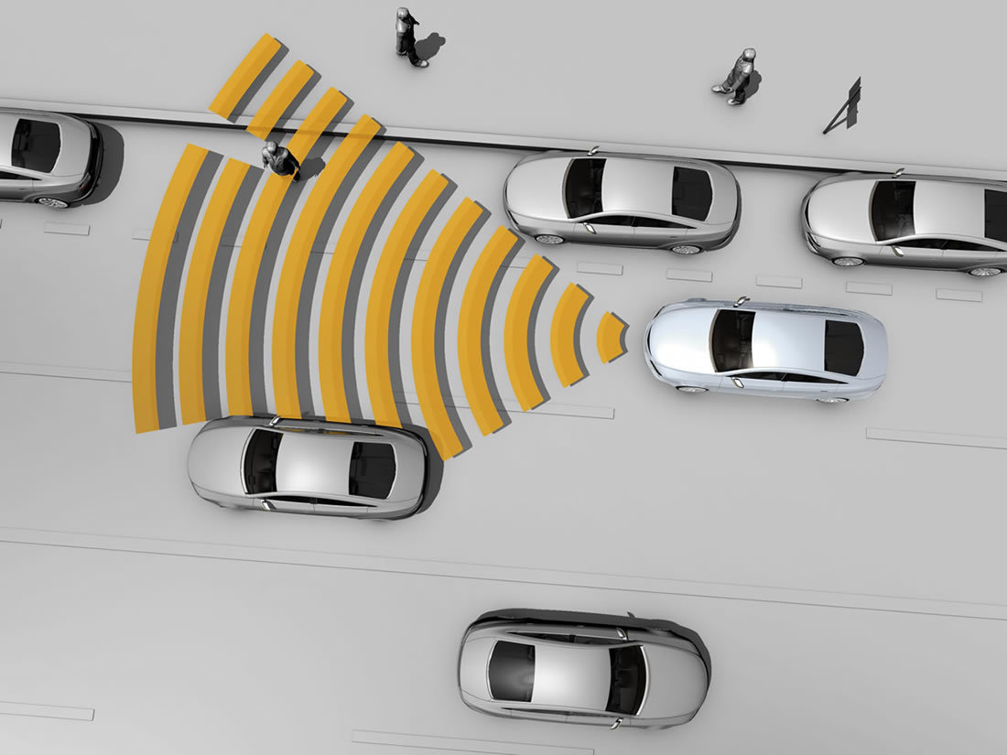
Collision Avoidance

Slide 8
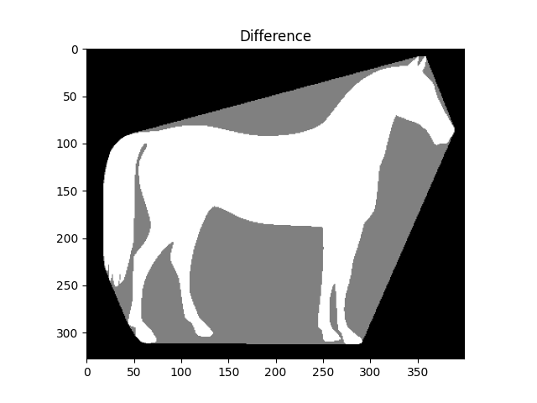
Image Processing

Slide 9
Algorithm
This code implements the Convex Hull algorithm.
The convexhull() function takes a list of n points as input and returns the set of points that form the convex hull. If there are less than or equal to 3 points, the function simply returns the original points as they are convex hull.
Equation of line (x2-x1)*(y3-y1)-(y2-y1)*(x3-x1).
The algorithm uses a brute force approach to check each pair of points to see if any other point lies on the left or right side of the line formed by the pair of points. The slope() function calculates the slope of the line formed by the three points. If the slope is positive, the point lies to the left of the line, and if it is negative, the point lies to the right. Points that lie on the line are ignored. The left and right points are stored in separate lists.
For each pair of points, if there are points only on one side of the line, those two points are added to the convex hull. Finally, the function returns the set of points in the convex hull.
The main function prompts the user to input the number of points and their coordinates, creates a list of points, and then calls the convexhull() function to compute the convex hull. The result is then printed.

Slide 10
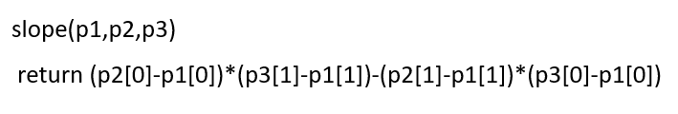
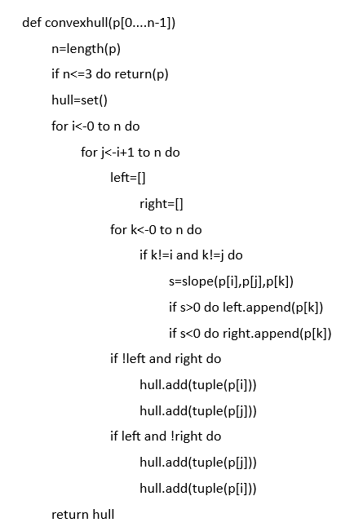
Algorithm

Slide 11
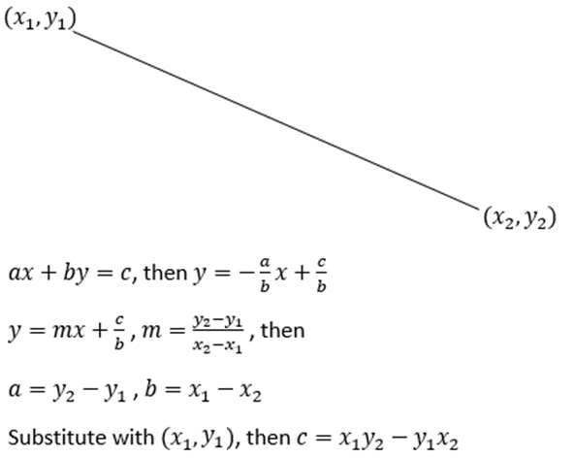

Slide 12
Time Complexity
Time complexity for slope(p1,p2,p3) function is θ(1).
Time complexity for convexhull(p) function is θ(n³).
The time complexity for the code is θ(n³).

Slide 13
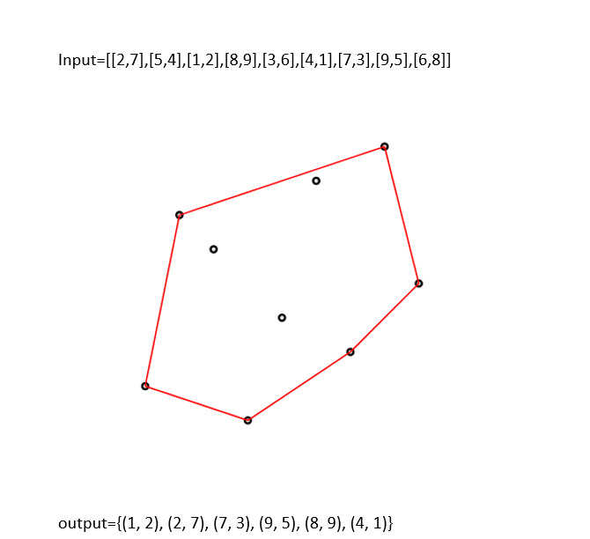
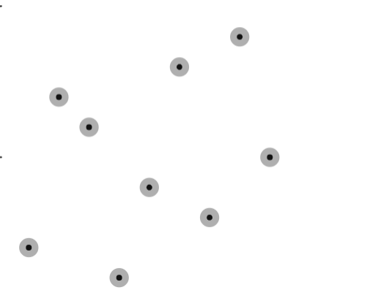
Test Case 1

Slide 14
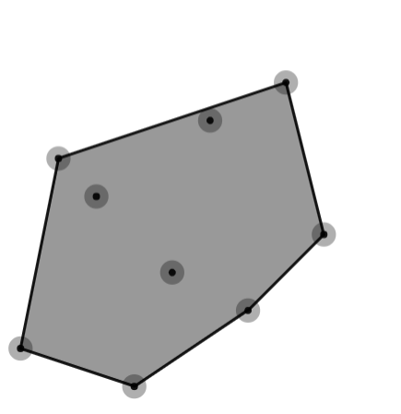
Test Case 1

Slide 15
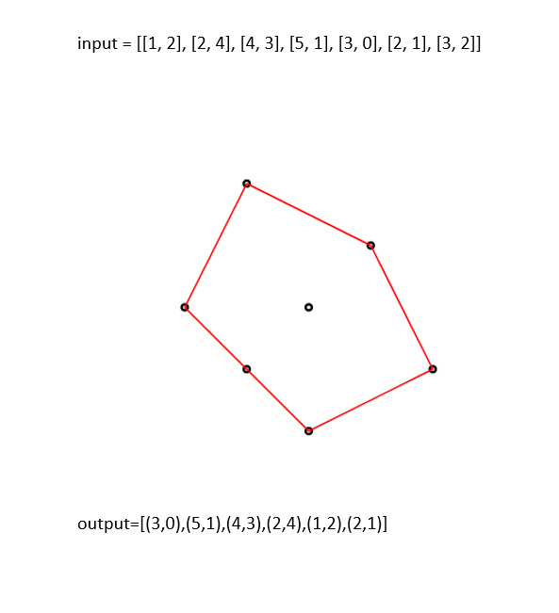
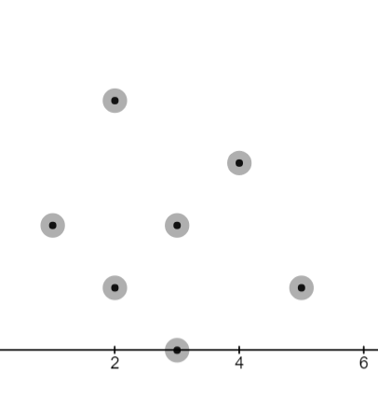
Test Case 2

Slide 16
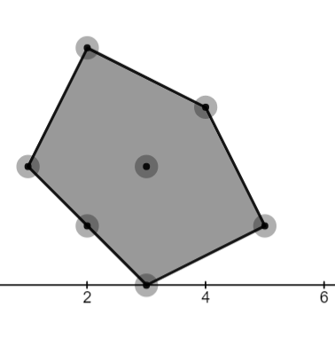
Test Case 2

Slide 17
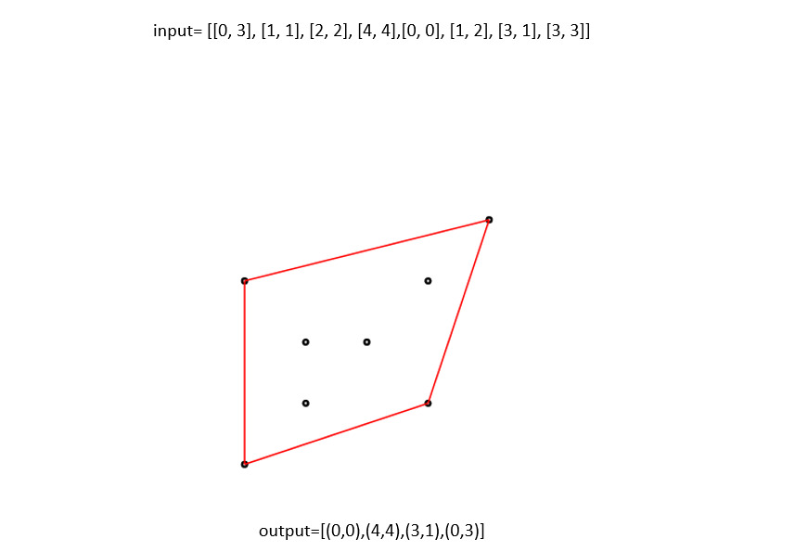
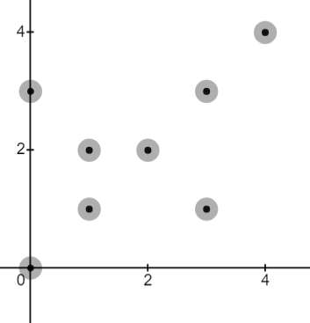
Test Case 3

Slide 18
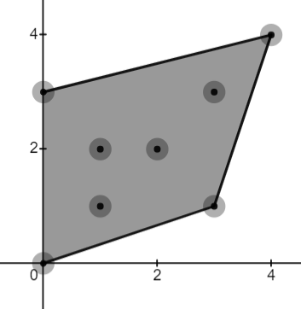
Test Case 3

Slide 19
Divide & Conquer
The Divide and Conquer algorithm for the Convex Hull problem:
Divide: Divide the set of points into two approximately equal-sized subsets based on their x-coordinate.
Conquer: Recursively find the convex hull of each subset. If the number of points is small (e.g., three or less), you can compute the convex hull directly.
Merge: Merge the convex hulls obtained from the two subsets to find the final convex hull. This step involves finding the upper and lower tangent lines between the two hulls.
Time Complexity is equal θ(n log n).

Slide 20
Divide & Conquer VS Brute-Force
Improved Time Complexity
Efficient Use of Information: The brute force algorithm considers all possible combinations of points. The Divide & Conquer algorithm strategically divides the problem space and only focuses on relevant subsets of points during each recursive step.
Optimal Subproblem Solutions: The Divide and Conquer algorithm solves smaller subproblems optimally and recursively combines their solutions to obtain the result. The brute force algorithm does not exploit any substructure of the problem and may involve redundant computations.
Scalability: The efficiency of the Divide and Conquer algorithm improves as the number of input points increases. The brute force algorithm becomes infeasible for larger point sets due to its cubic time complexity.

Slide 21
Thank You!

